Slide 1
进度报告20170727 CCA 结果分析
李佳蔚

Slide 2
CCA speaker listener
频段选择：broadband 0.5-40Hz

Slide 3
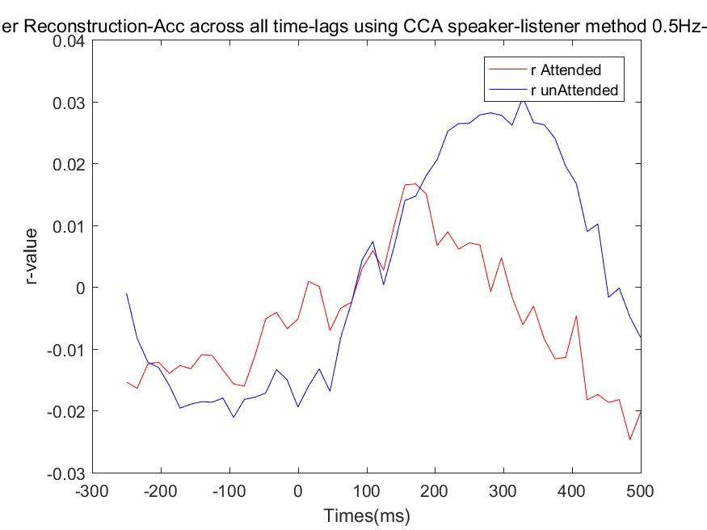
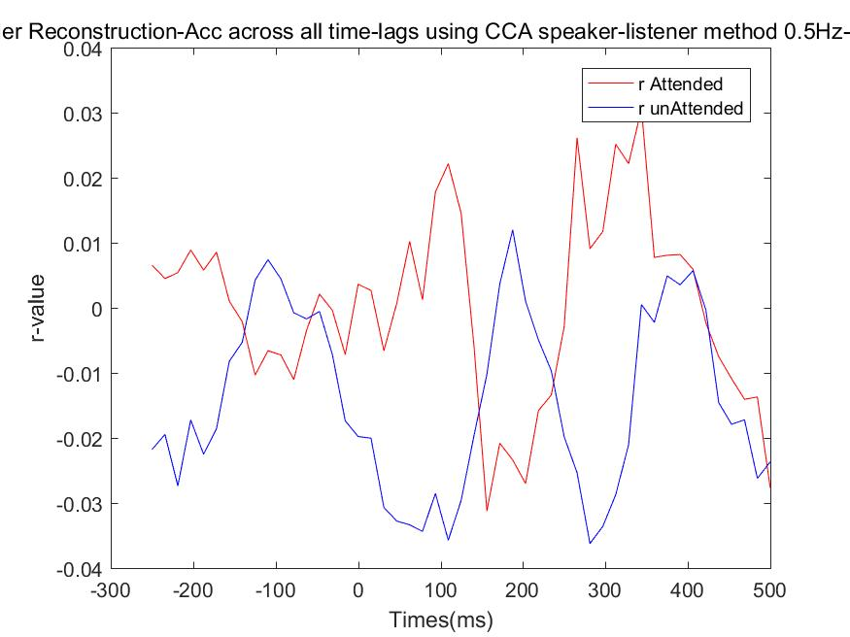
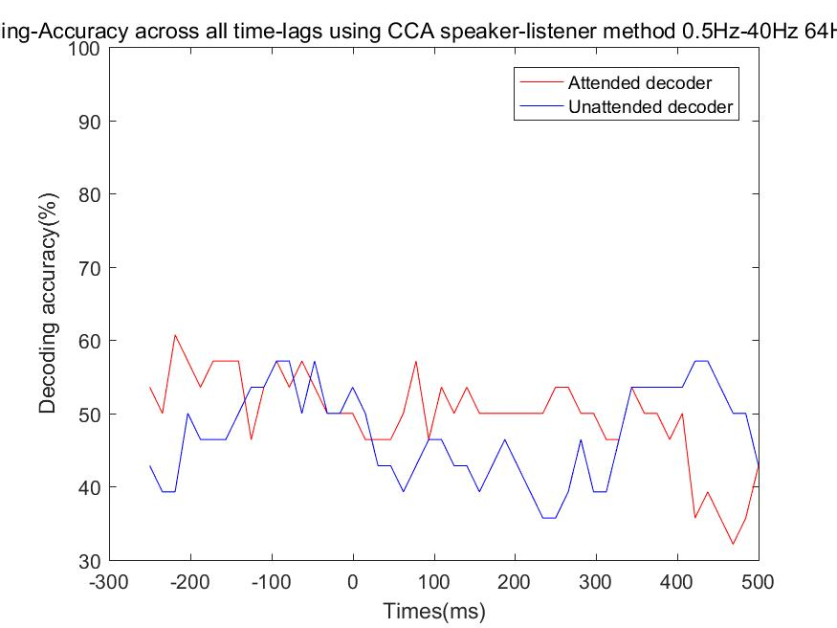
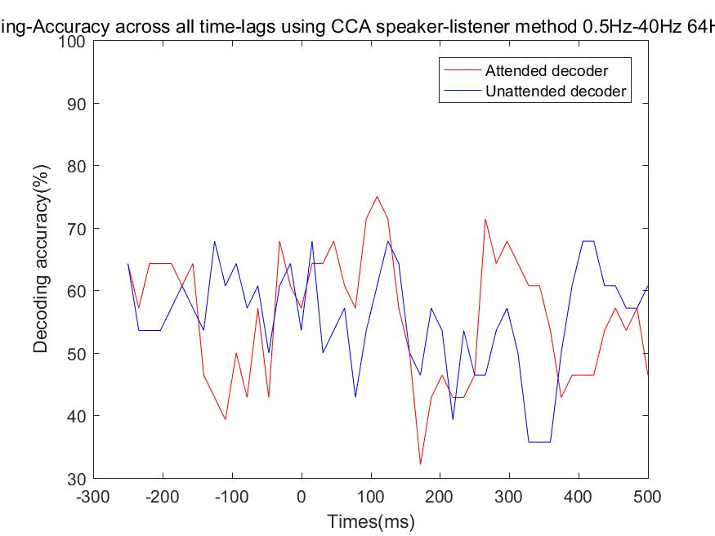
CCA speaker listener – listener0
R rank1
R rank5
r value
Decoding result

Slide 4
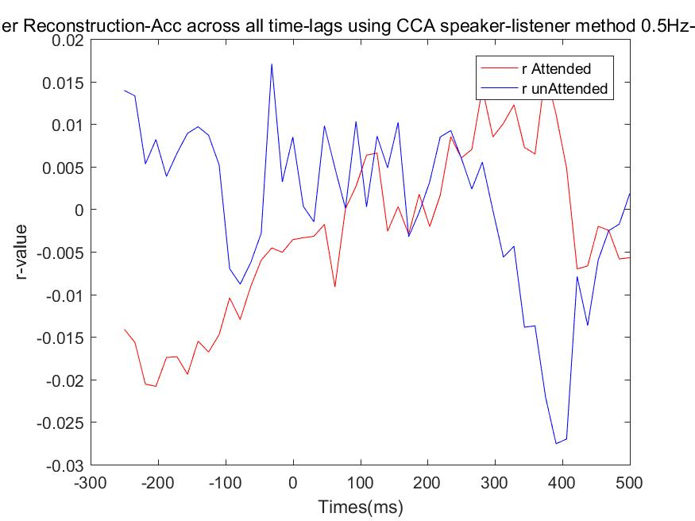
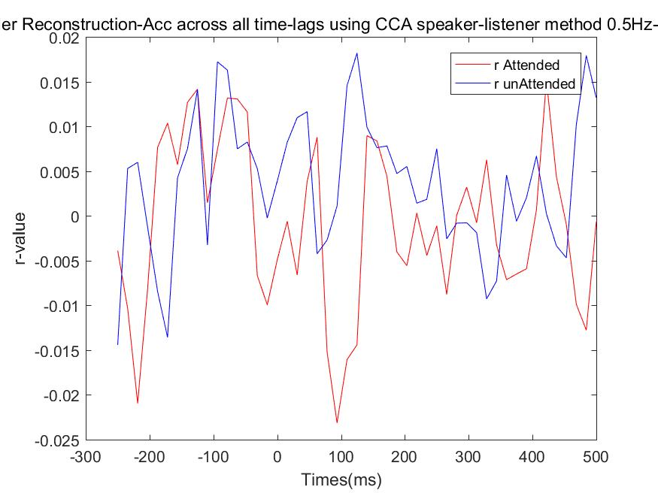
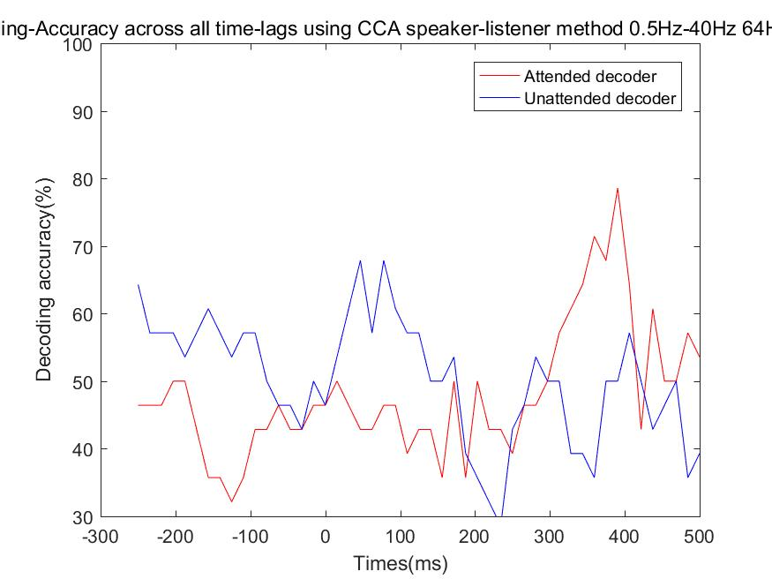
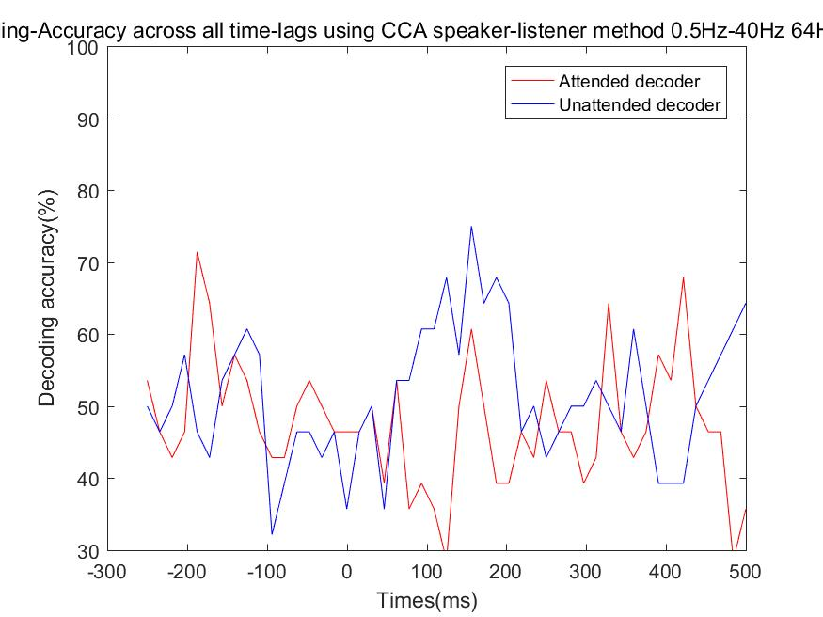
CCA speaker listener – listener0
R rank1
R rank5
r value
Decoding result

Slide 5
CCA sound EEG
频段选择：theta 2-8Hz

Slide 6
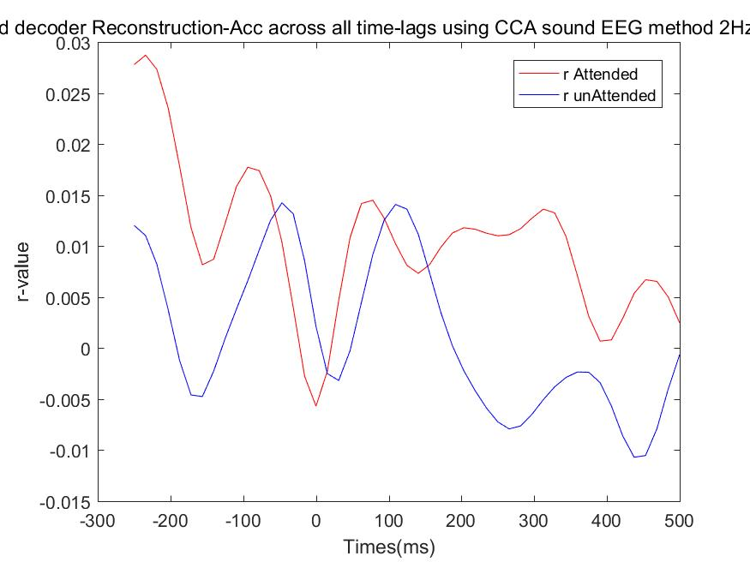
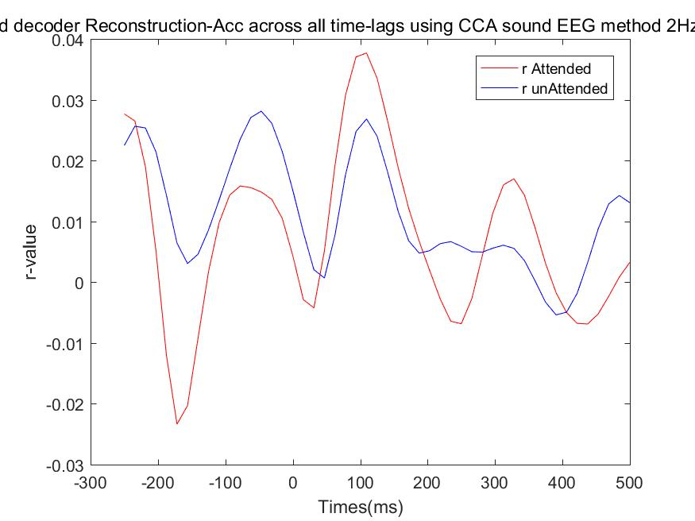
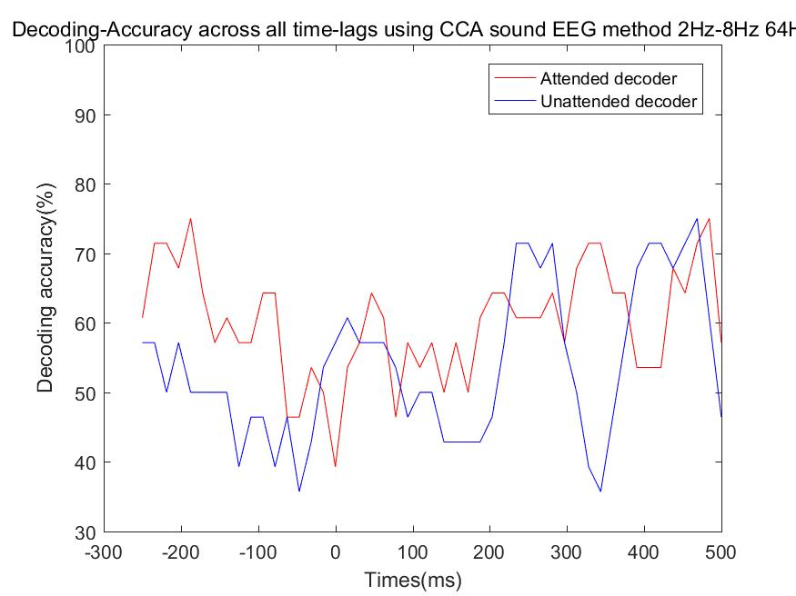
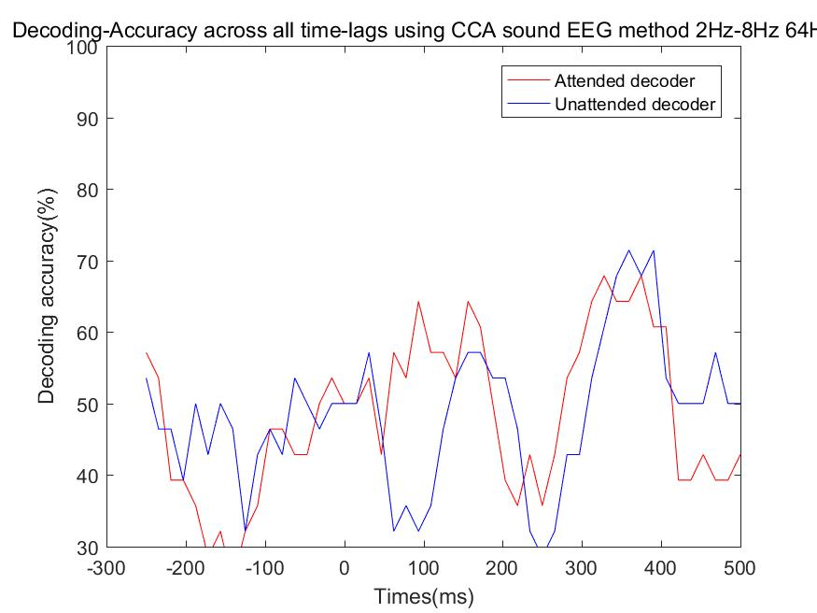
CCA sound EEG
listener0
listener01
r value
Decoding result

Slide 7
mTRF

Slide 8
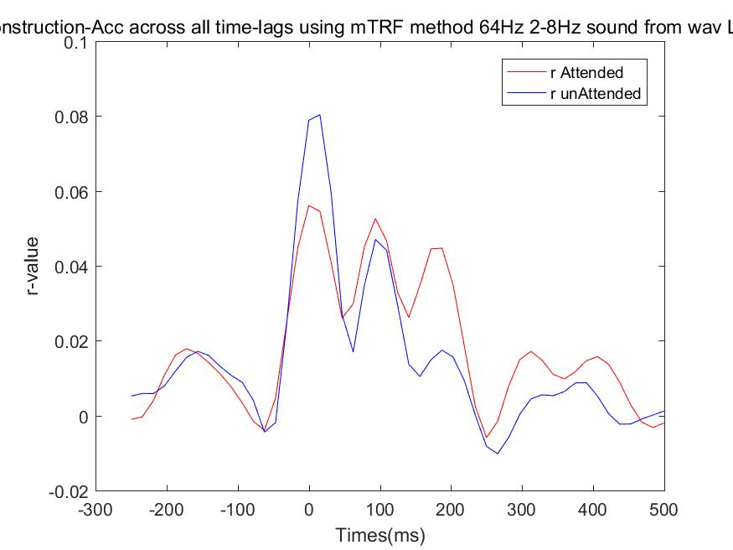
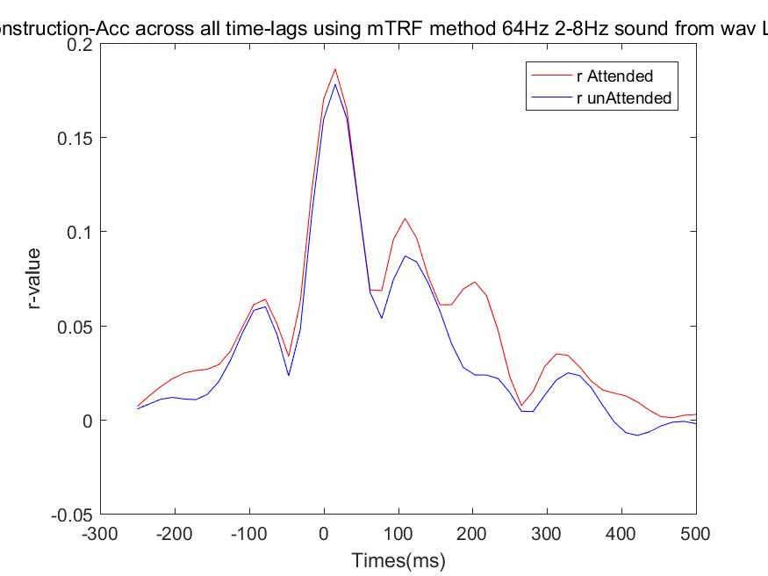
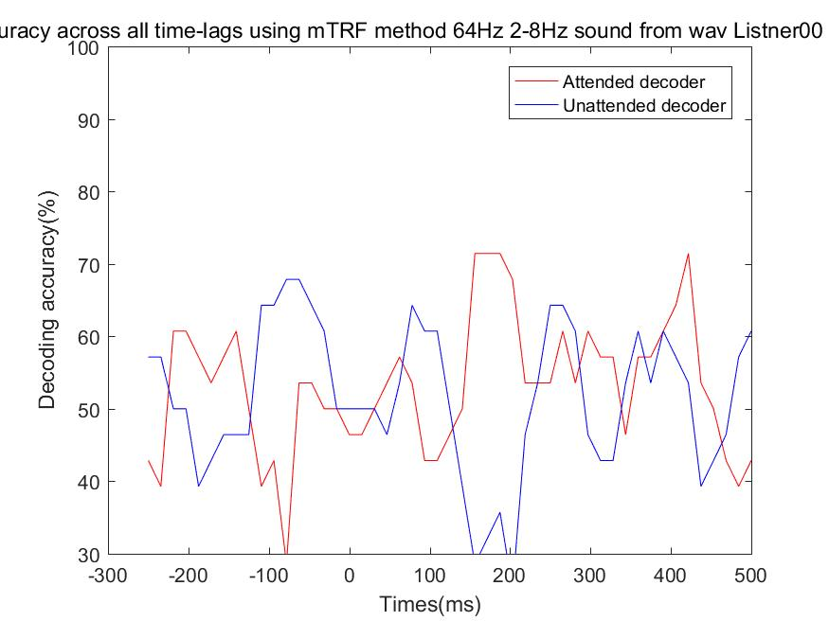
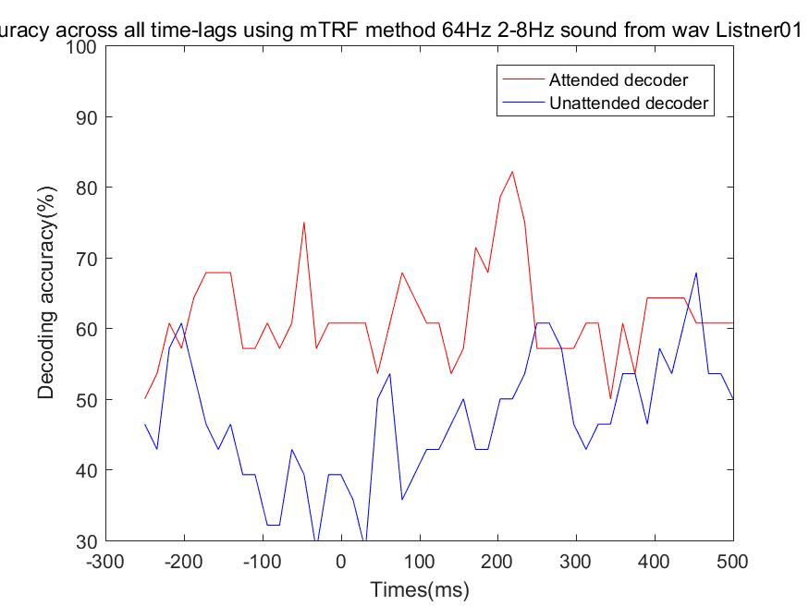
mTRF
listener0
listener01
r value
Decoding result

Slide 9
Thanks！

